Slide 1
Sales Trends and Customer Retention Plan
Factors Driving Insights:
Sales ‘Peak’ in January. It is assumed that the promotions and deals offered during the holiday season is driving sales. This is consistent across all customer segments
Max Sales revenue come from categories – Women and Make-up. The least sales from category- Sun. Sun products sell during holiday season(driven by promotions/discounts) and summer season.
VIP and LOYAL customers fare better off-season compared to Other Customers- predominantly Infrequent and One-off.
VIP Customers bring in the max sales by category compared to loyal customers.
Recommendations:
Customer retention should be the focus to increase sales both on and off season as VIP and LOYAL customers seem to keep the trend consistent.
Loyalty programs and VIP customer benefits/promotions should be increased both for retention of existing customers and to attract other segments. (slide 3 avg sales price comparisons)
Customer conversion should focus on ‘Loyal’ to ‘VIP’ conversions.
Promotions/deals on Men products to increase sales.

Slide 2
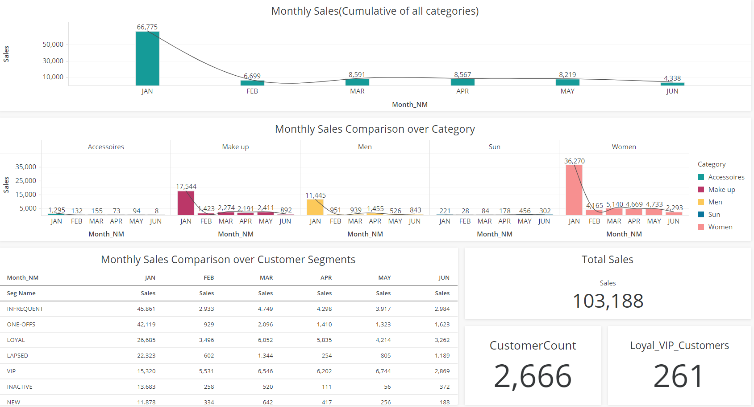

Slide 3
